Slide 1
Prospective developments for innovation and competitiveness
Filippo di Mauro (*)
Chairman of CompNet
30th June 2022-Session 16.00
(*) with contribution from Eric Bartelsman, Mirja Hälbig, Laura Marie Lufray and Alessandro Zona Mattioli
Notes:
Introduction
Motivation
Architecture

Slide 2
Innovation: their impact and how do we measure it?
Two policy research questions:
Are intangible assets associated with higher profits, firm size and productivity?
How do they relate to concentration, market power and wages?
Do different metrics of intangible assets deliver the same picture?

Slide 3
First, how we define intangibles
We define intangibles in different ways using the two CompNet micro-based datasets:
MDI (more granular, available for 6 EU countries)
Investment in concessions, patents, licences, trademarks and similar rights
Perpetual Inventory Method (PIM) estimated intangible assets
Innovation and Organization capital from Innovation survey (CIS)
Share of personnel using computers at the workplace (from ICT survey)
R&D intensity
CompNet (available for 20)
Balance Sheet item from the Assets side: intangible assets
Notes:
1. Investment in concessions, patents, licences, trademarks and similar rights: comes from SBS, and it is the part of investment that is devoted to purchasing licences, patents, rights to use intellectual property
2. Cumulating investment through the years and assuming a rate of depreciation, we can estimate capital (this is called the perpetual inventory method).
3. From a set of survey questions (eg did your firm adopt new marketing practices? did you introduce changes into work organization? Did you develop a new product?) and other covariates (such as firm size, age, etc) we estimate a probability of innovating (through a Probit model) that is a proxy of the value of the intangible capital present in the firm.
This is done by extracting survey indicators that are available in multiple countries and by harmonizing them so to have a comparable variable.
4. As a proxy of ICT intensity, we compute the % of workers using a computer every day in the work force.
5. This a measure of R&D expenditure / total revenues.

Slide 4
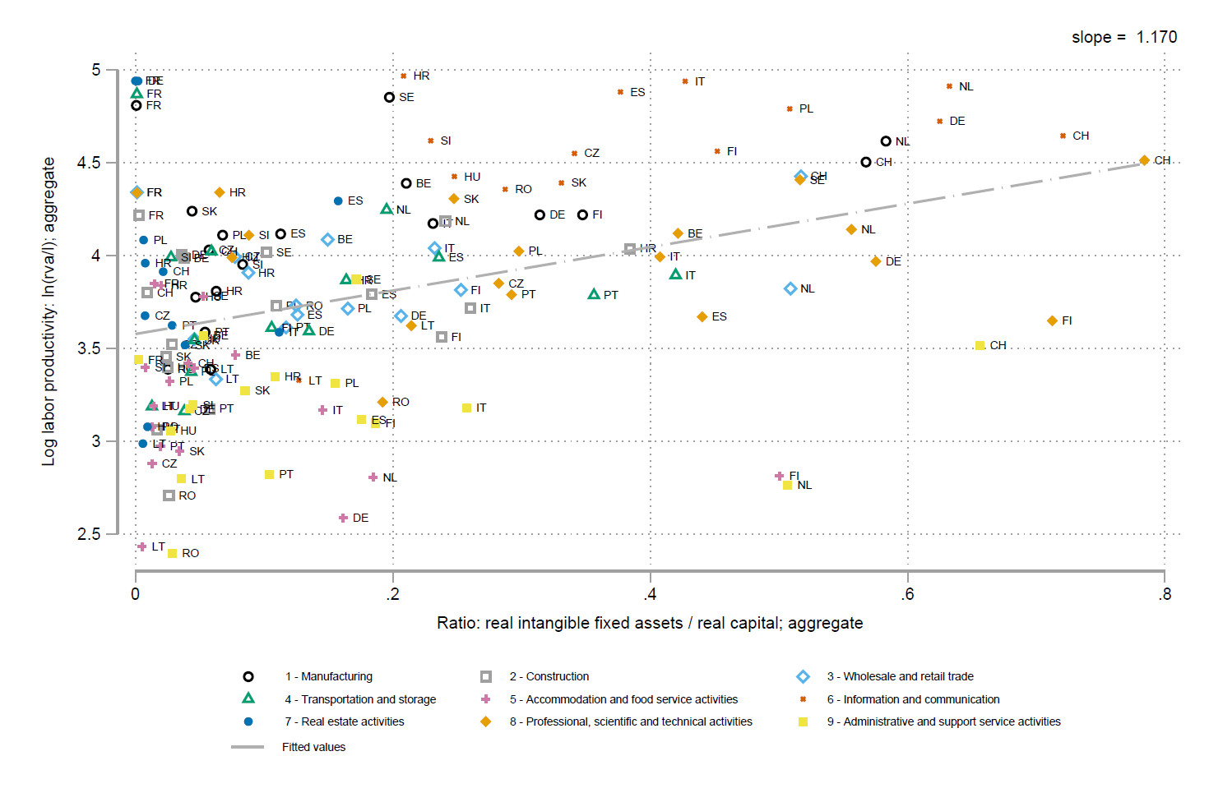
The broader picture (compNet): Intangibles and productivity
….are positively correlated across sectors and countries
Notes:
Intangibels are positively correlated with productivity

Slide 5
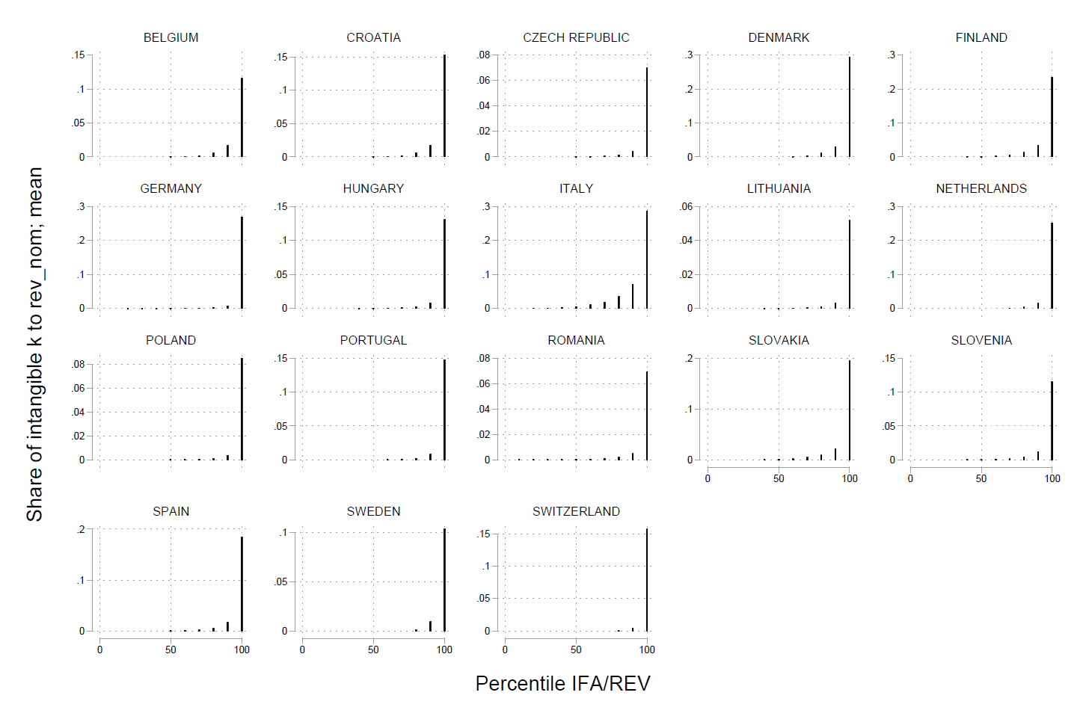
Intangible assets ownership is very concentrated
….only the very top firms (the last percentile on the right) invest high shares of their revenues in intangible assets
Notes:
Intangibles are very concentrated in the largest firms.

Slide 6
More granular data (MDI) give a more nuanced picture
FR
NL
….Firms results (profit, revenues) are highly skewed when using innovation index as a proxy for intangibles
Notes:
By using other indicators we can get a more nuanced picture:
1- there remains possitive correlation, but we see that it is less than before: R&D in France is mainly carried out by small subsidiaries that are controlled by larger corporations. Profits/size and revenues do not vary too much by ICT intensity as most firms are relatively ICT intensive. Innovation capital is still very skewed.

Slide 7
Intangibles are correlated with concentration in revenues
Notes:
Mainly driven by the ICT sector

Slide 8
But less with markups
….Those firms NO necessarily can enjoy undue market power
Notes:
Unclear whether they are correlated with markups

Slide 9
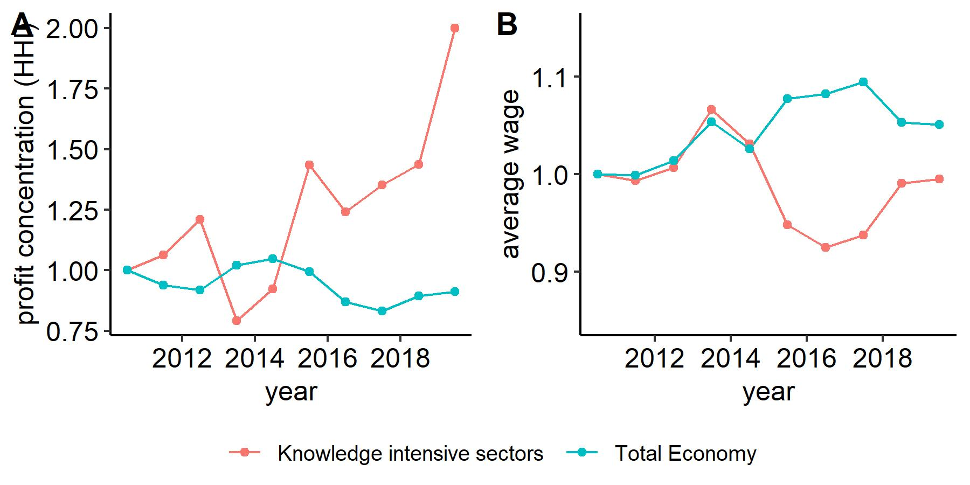
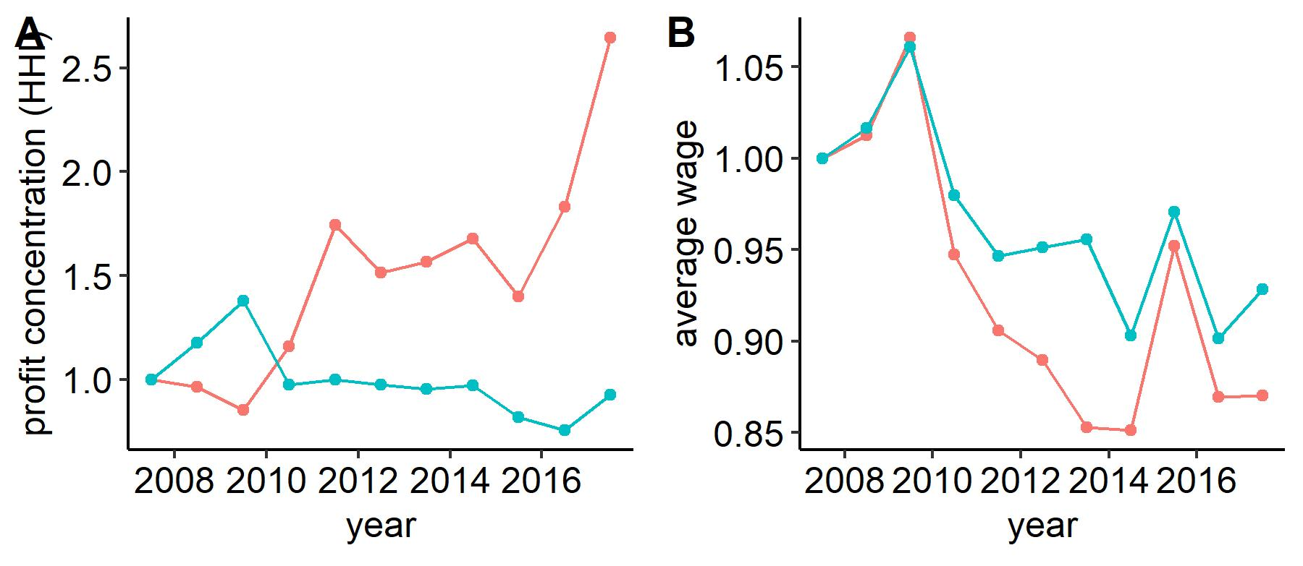
…Although more granular data (MDI) point to high concentration in profit overtime for KI firms and wage discrepancies in FR
FR
NL
Notes:
Knowledge intensity is defined as a reaggregation of industry codes, based on their share of R&D and ICT intensity. Provided by Eurostat.
We can show a time trend where for knowledge intensive sectors, concentration in profits is increasing more than the total economy, while wages are stagnating (again for NL and FR). Could be sign of problems of distribution coming from intangibels

Slide 10
Conclusions - 1
Intangible assets are a key variable
They imply multiple measurement challenges and we dwell on that
Intensity in intangible assets is associated with better firm performance (productivity, profits, size…)
Particularly for top firms, that benefit from high intangible intensity!
But it is yet unclear whether they have a positive impact on wages and competition (markup – market power)
Need to identify possible market failures that policy could address (in terms of wage inequality or excess concentration)

Slide 11
Thanks for your attention
Check on www.comp-net.org

Slide 12
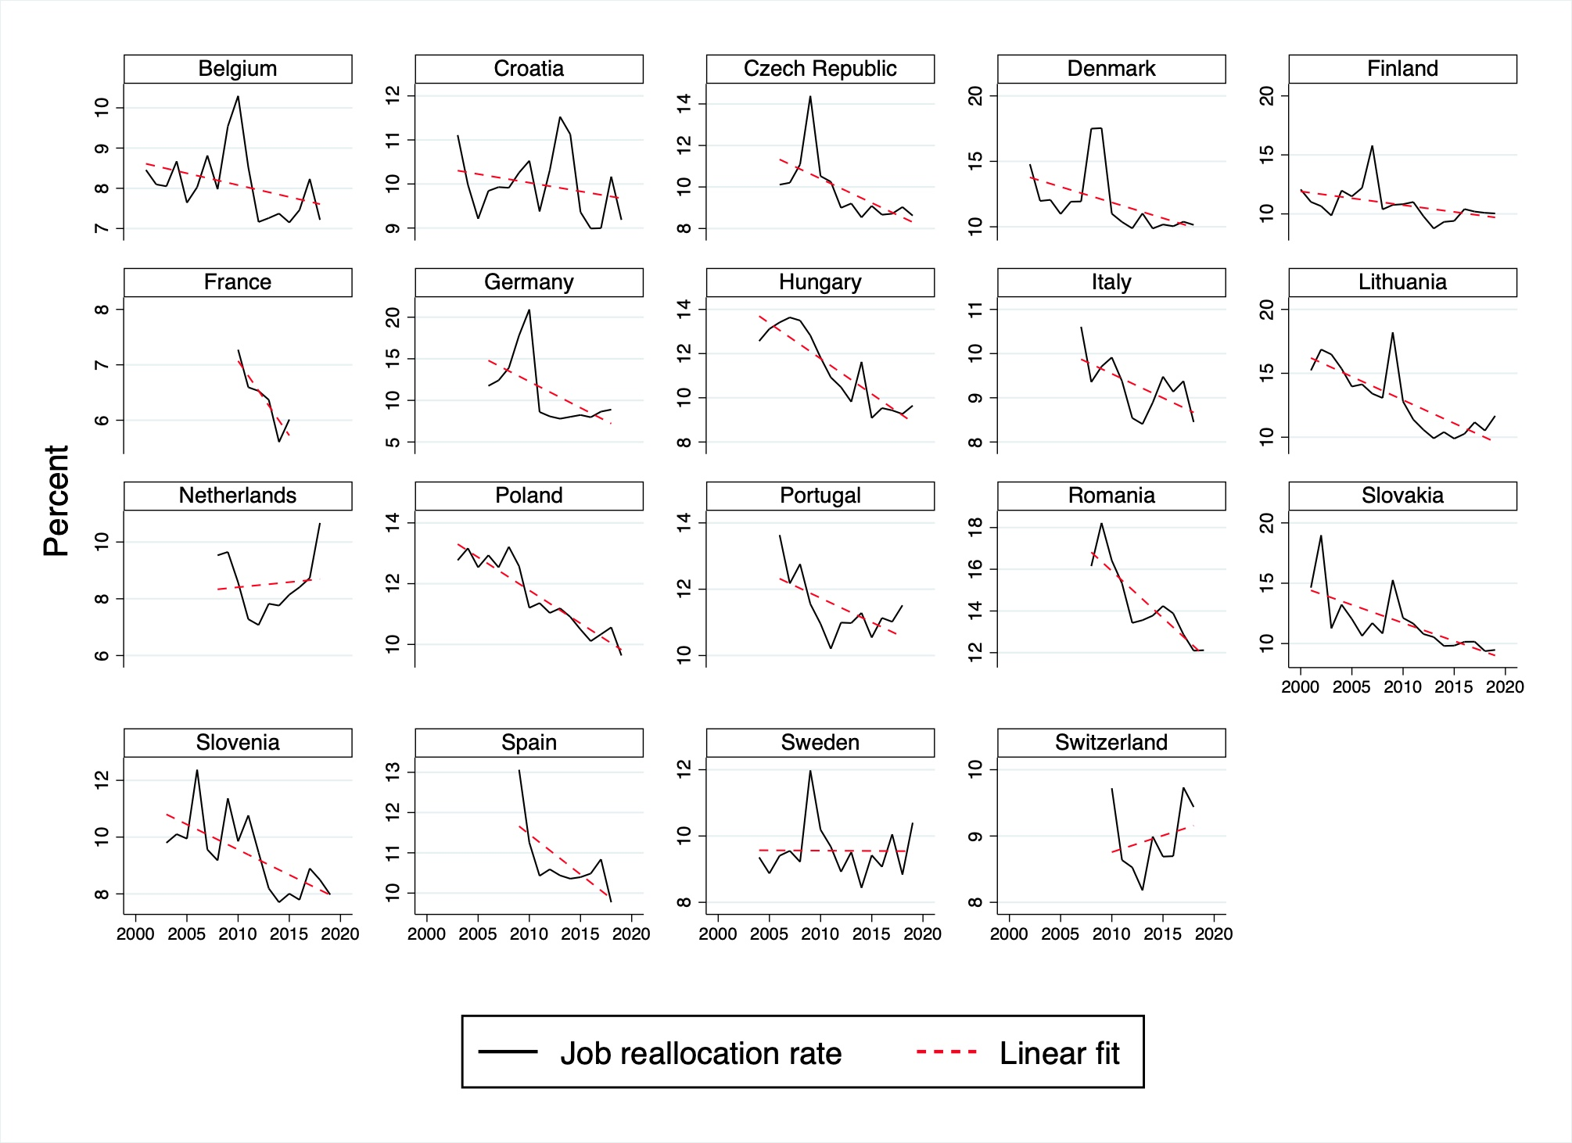
Business dynamism is declining
The slowdown in innovation can be due to a less dynamic economy
The flow of resources (workers) between firms is declining across Europe
Notes:
Knowledge intensity is defined as a reaggregation of industry codes, based on their share of R&D and ICT intensity. Provided by Eurostat.
We can show a time trend where for knowledge intensive sectors, concentration in profits is increasing more than the total economy, while wages are stagnating (again for NL and FR). Could be sign of problems of distribution coming from intangibels

Slide 13
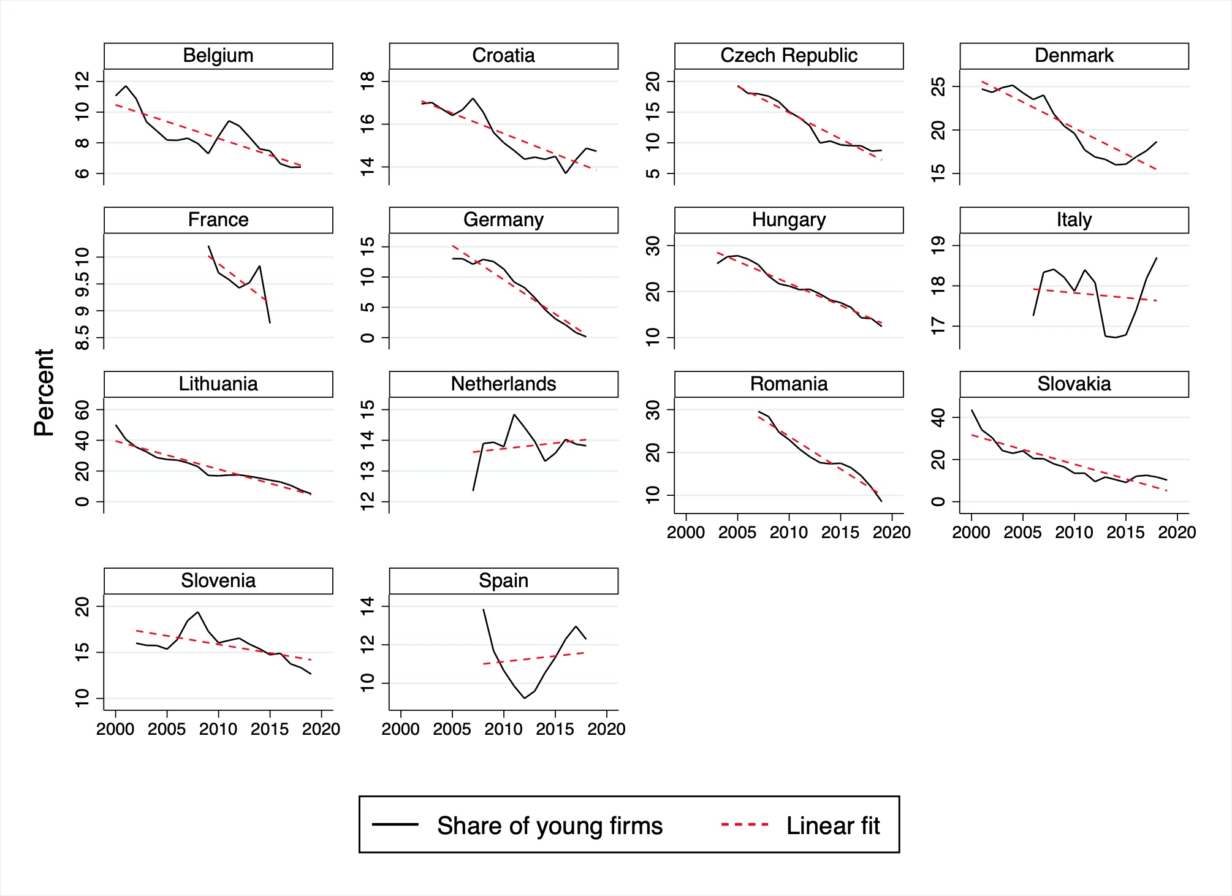
Entry is becoming increasingly difficult
Notes:
Knowledge intensity is defined as a reaggregation of industry codes, based on their share of R&D and ICT intensity. Provided by Eurostat.
We can show a time trend where for knowledge intensive sectors, concentration in profits is increasing more than the total economy, while wages are stagnating (again for NL and FR). Could be sign of problems of distribution coming from intangibels

Slide 14
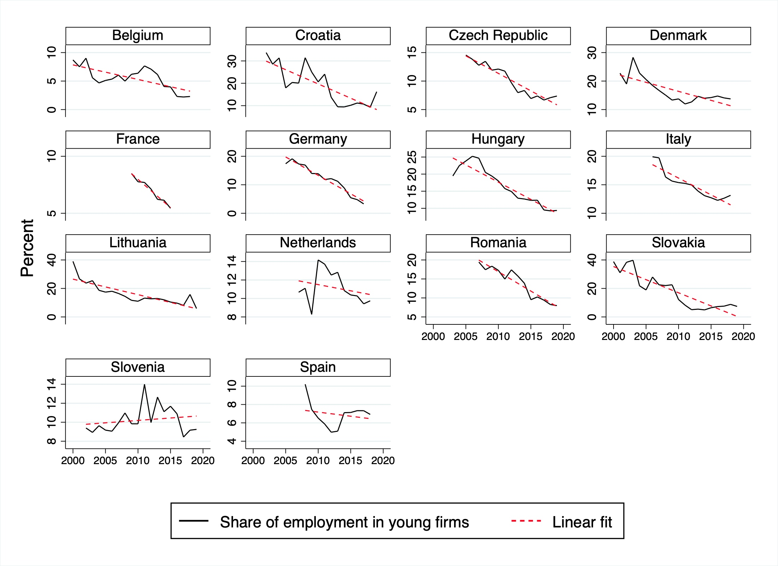
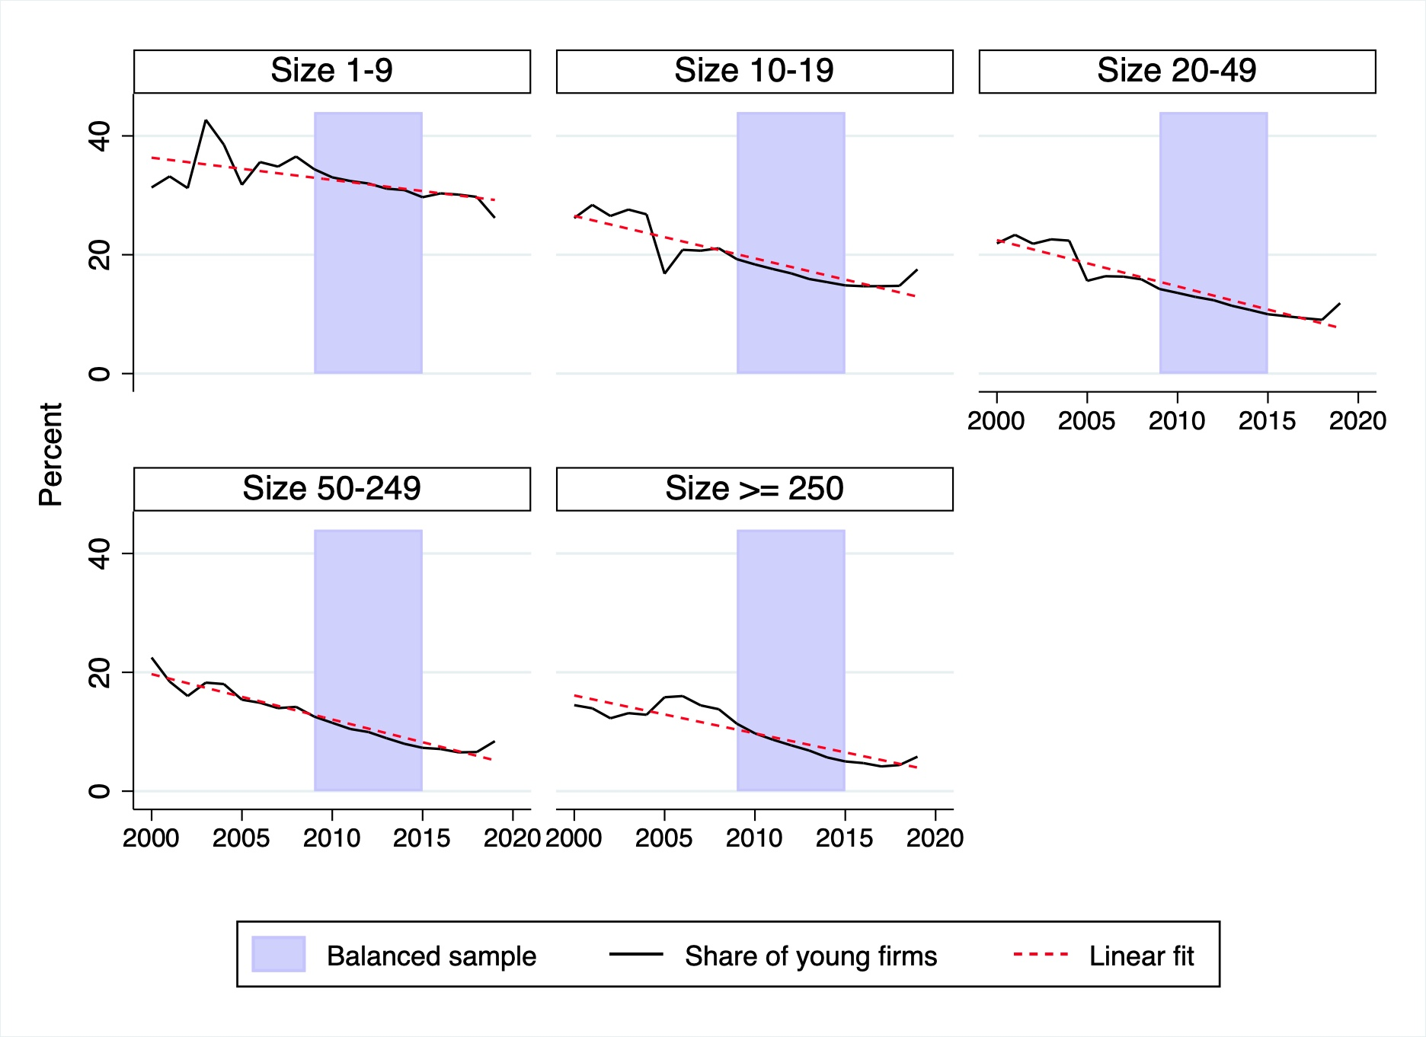
Young firms are becoming less important
Share of employment in young firms
Share of young firms by size-class
Notes:
Knowledge intensity is defined as a reaggregation of industry codes, based on their share of R&D and ICT intensity. Provided by Eurostat.
We can show a time trend where for knowledge intensive sectors, concentration in profits is increasing more than the total economy, while wages are stagnating (again for NL and FR). Could be sign of problems of distribution coming from intangibels

Slide 15
Conclusions - 2
Innovation is crucial for every economy because it fuels growth
The decline in business dynamism is worrisome since young firms are those who drive innovation!
Anticompetitive behavior can hamper entry: is this happening in Europe?
We are currently investigating whether product market power and monopsony power are driving the decline in business dynamism
Notes:
Knowledge intensity is defined as a reaggregation of industry codes, based on their share of R&D and ICT intensity. Provided by Eurostat.
We can show a time trend where for knowledge intensive sectors, concentration in profits is increasing more than the total economy, while wages are stagnating (again for NL and FR). Could be sign of problems of distribution coming from intangibels

